Slide 1
Keys in DBMS

Slide 2
Keys
Keys play an important role in the relational database.
It is used to uniquely identify any record or row of data from the table. It is also used to establish and identify relationships between tables.
For example, ID is used as a key in the Student table because it is unique for each student. In the PERSON table, passport_number, license_number, SSN are keys since they are unique for each person.

Slide 3
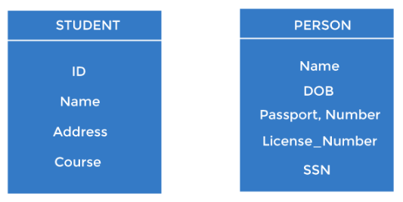

Slide 4
Types of Keys in DBMS
Super Key
Primary Key
Candidate Key
Alternate Key
Foreign Key
Composite Key
Surrogate Key

Slide 5
Super key
A superkey is a group of single or multiple keys which identifies rows in a table.
A Super key may have additional attributes that are not needed for unique identification.
Like Superset, from which we can derive other keys.

Slide 6

Example

Slide 7
Candidate Key
CANDIDATE KEY in SQL is a set of attributes that uniquely identify tuples in a table. Candidate Key is a super key with no repeated attributes.
The Primary key should be selected from the candidate keys. Every table must have at least a single candidate key. A table can have multiple candidate keys but only a single primary key.
Properties of Candidate key:
It must contain unique values
Candidate key in SQL may have multiple attributes
Must not contain null values
It should contain minimum fields to ensure uniqueness
Uniquely identify each record in a table

Slide 8

Example

Slide 9
Primary Key
PRIMARY KEY in DBMS is a column or group of columns in a table that uniquely identify every row in that table.
The Primary Key can’t be a duplicate meaning the same value can’t appear more than once in the table.
A table cannot have more than one primary key.

Slide 10
Rules for defining Primary key
Two rows can’t have the same primary key value
It is must for every row to have a primary key value.
The primary key field cannot be null.
The value in a primary key column can never be modified or updated if any foreign key refers to that primary key.

Slide 11

Example

Slide 12
Alternate key
ALTERNATE KEYS is a column or group of columns in a table that uniquely identify every row in that table.
A table can have multiple choices for a primary key but only one can be set as the primary key.
All the keys which are not primary key are called an Alternate Key.

Slide 13

Example

Slide 14
Unique key
Key that is unique in terms of values but can also have null values is called unique key.
In the upcoming example email, {name,phone} etc can be unique keys.

Slide 15

Example

Slide 16
Composite key
COMPOSITE KEY is a combination of two or more columns that uniquely identify rows in a table.
The combination of columns guarantees uniqueness, though individually uniqueness is not guaranteed. Hence, they are combined to uniquely identify records in a table.

Slide 17

Example

Slide 18
Foreign key
FOREIGN KEY is a column that creates a relationship between two tables. The purpose of Foreign keys is to maintain data integrity and allow navigation between two different instances of an entity.
It acts as a cross-reference between two tables as it references the primary key of another table.

Slide 19

Example

Slide 20
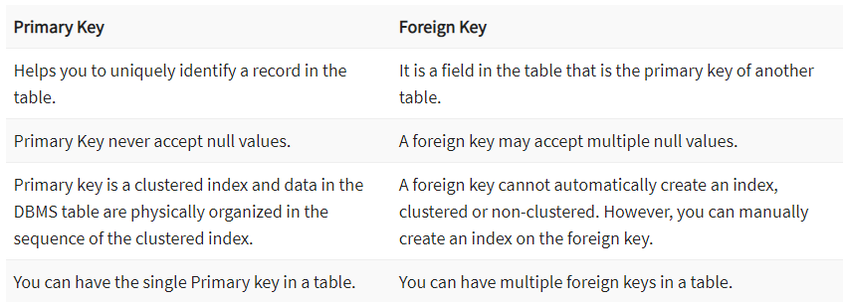
Difference Between Primary key & Foreign key

